Slide 1
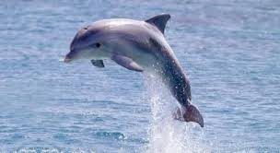
CSCI 2141 Final Project
Database and Web Application For Pelagic Predator Tagging System (PPTS)

Slide 2
Pelagic Predator Tagging System (PPTS)
Theoretical system for tagging marine animal species in order to track movement, temperature, depth, etc.
Based on real world tagging systems such as the TOPP Survey run by Stanford University.
Dalhousie University has a similar program entitled the Ocean Tracking Network (OTN).

Slide 3
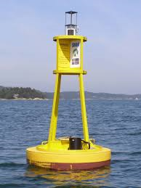
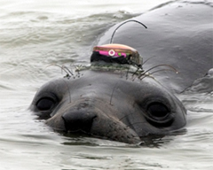
PPTS
PPTS starts with the attachment of radio transmitter tags to a wide variety of marine species.
Tags are detected by a series of buoys in the ocean.
Each buoy transmits their data to stations on land via a satellite network where the data can be organized for analysis.

Slide 4
Data Redundancy and Integrity in TOPP Data
Real world tagging systems such as TOPP tabulate their data in tables for each species tracked.
Involves a great deal of redundancy as each table contains the same columns.
These tables do not conform to 1NF form.

Slide 5
Sample TOPP Data Table

Slide 6
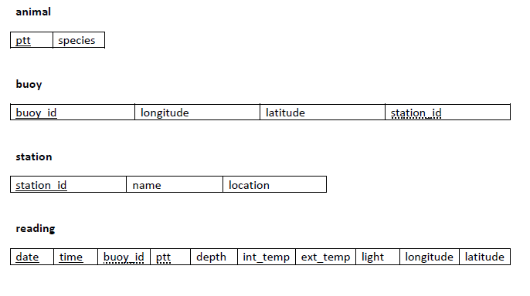
Proposed Database Schema

Slide 7
Normalization
Proposed db schema reduces redundancy by taking original datasets and first putting them in 1NF.
After this we further decompose our structure to ensure no function dependencies by non-primary key attributes.
Separate the animal, buoy, and station into individual entities each with their own table as well as a 4th table to house individual data readings.

Slide 8
Tools used in Database Creation
Database was created with phpmyadmin within an XAMPP environment with an SQL backbone
Locally hosted web server run using Apache, also under XAMPP.
Web application makes use of the database through a php/html interface.

Slide 9
Web Application
Allows user to query the reading table of our database in order to view only the columns they are interested in.
Results presented in a table format and can be ordered by different attribute types and sorted in ascending or descending order.

Slide 10
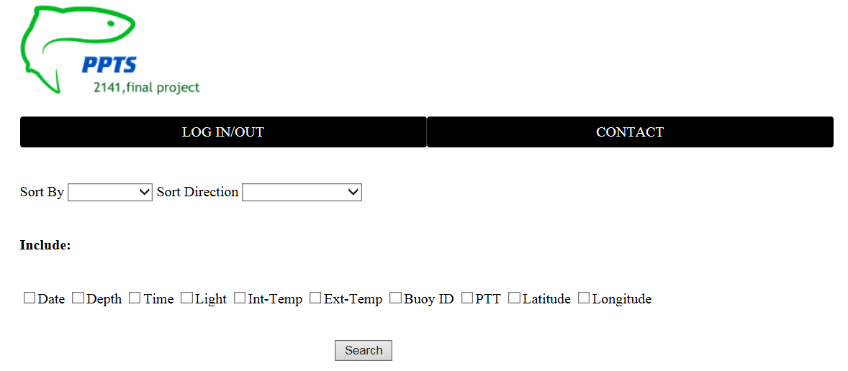
Web Application

